Slide 1
Championing Christian Workplace Groups
Jeff Steady
Chair, Transform Work UK
Notes:
Welcome to the Transform Work UK AGM conference for 2016. We passionately believe in the vision we have for transforming secular workplaces in this nation and beyond. This conference day will present to you a broad range of the factors we face and the progress achieved so far. I hope you enjoy the day and benefit from it. Please talk to me and other members of our team during the day so we can get to know each other.

Slide 2
The Challenge
Christian Influence in the workplace
Christians feeling isolated and powerless
How do you make a difference?
Notes:
Transform Work UK realised long ago that in this country there is a huge gap in Christian influence in the secular business houses and organisations of the nation. Key leaders in secular workplaces are not being pastored. Yet recent business history spells out clearly the need for significant Christian influence, and legislation emphatically permits freedom of expression in every situation and positively implores Christians among others to make their influence felt. It’s not that Christians are not present in the workforces of the nation – they clearly are – and they are eager to be an effective witness, but they often feel isolated and powerless. What’s more in our experience, apart from a few exceptions, employers are more than open to credible Christian influence. But how to make to the difference?

Slide 3
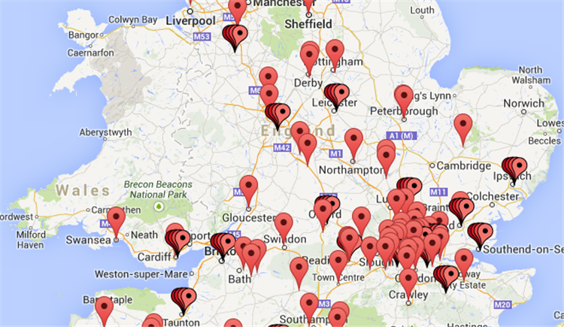
Transform Work Response
Christian Workplace Groups:
Outward facing
Engages with management
Open to entire organisation
Notes:
In our view, all this can be changed significantly for the good.
We set out to replicate successful Christian workplace groups with an outward facing style – a style that engages with management to open up the entire organisation to Christian influence. We set out to develop dynamic best practice and provide matching resources to help Christians make a real difference.
We set out to provide a lively and passionate team that would be always on hand to support and provoke you in establishing Christian workplace groups and in making their presence felt. And we also wanted our team, so passionately do we believe in the vision we have, to energetically seek to increase the numbers of Christian Workplace Groups across the nation. Progress to date sees 400 groups of varying types and sizes on our books. In addition we have 53 individuals in a wide range of organisations working with us to begin new groups. It is a beginning, and a good one. Let’s go for a thousand!

Slide 4
Transform Work Team
Operations
Support Services
Lead – Jeff Steady
Lead Ambassadors:
Ros Turner
Elizabeth Ukiomogbe
Ambassadors:
Dave Law, Reading
Alan Holdsworth, Birmingham
Rick Pearl, Cardiff
Catherine Crook, London
John Kay, Cardiff
Lead – Michael Coveney
Adrian Miles – Publications
Trevor Payne – Website, Newsletters
Jayne Payne – Finance & Admin
Lilian Ajose – Legal
Joe Walsh – Prayer
Jay Paternoster - Admin
- Also trustees
Notes:
We have been busy to turn our dreams into reality. Over time, we created Transform Work UK as a registered charity upheld by a team of PRAYER WARRIORS. Our trustees are MICHAEL COVENEY - SUPPORT SERVICES LEAD (STAND, WAVE AND STAY STANDING) TREVOR AND JAYNE PAYNE (IT AND FINANCE LEADS) LILIAN AJOSE (LEGAL LEAD) AND ADRIAN MILES (PUBLICATIONS LEAD – UNWELL TODAY). (ALL SIT) THEN THERE IS ROS TURNER, WHO BOTH TRUSTEE AND A LEAD AMBASSADOR (STAND, WAVE AND STAY STANDING) AND ELIZABETH UKIOMOGBE, LEAD AMBASSADOR (STAND) and OUR TEAM OF AMBASSADORS INCLUDING DAVE LAW, READING, ALAN HOLDSWORTH, BIRMINGHAM, RICK PEARL, CARDIFF, CATHERINE CROOK, LONDON, AND JOHN KAY, CARDIFF.
And in Support Services our latest recruits are Joe Walsh (Prayer Team) and Jay Paternoster who helped out in organising this conference.

Slide 5
Finances
2016 2015
TURNOVER £24,978 £14,809
Administrative expenses £19,349 £17,774
OPERATING (DEFICIT)/SURPLUS £ 5,629 £ (2,965)
CASH RESERVES:
Balance brought forward £ 5,130 £ 8,095
Cash in Hand £ 43 43
TOTAL BALANCE BROUGHT FORWARD £ 5,173
BALANCE CARRIED FORWARD £10,802 £ 5,173
Notes:
On finance, while most of our team are volunteers, our lead ambassadors are paid contractors and there is a wide range of other expense. In these days you have to do things to a good standard to meet modern requirements as well as to stay afloat.
On the screen you can see our finances for the last year. We have been funded to the present time by generous donors, some old, some new, without whom we would not be here. To achieve our goals, we need new key donors and new sources of income. We are a faith based organisation. We recently took on an additional Lead Ambassador when we did not have adequate funds but it has not harmed our balances as you can see. We seek to maintain a wise level of balances but we are now ready for another step of faith to engage a third lead ambassador. We also need new key players in a range of roles, possibly including chief executive. Join us!

Slide 6
Conclusion
Only organisation dedicated to Christian Workplace Groups with an outward facing focus
Dedicated, skilled and passionate team
400 CWGS, 48 CPSGs
Exciting VISION, STRATEGY and plan of ACTION
Notes:
As we stand then, Transform Work UK, is the largest if not the only organisation specifically dedicated to the creation and development of Christian Workplace Groups with an outward facing focus. We have in place a highly skilled and passionate team that can only be the gift of God. We have a large number of groups we seek to serve well and we are aiming for increase. With your help, we have unique publications, a dynamic website, prayer support, and more.
We have exciting VISION, clear STRATEGY AND sustained ACTION.
But it has been well said that you cannot display your sailing skills if there is no wind.
What we seek to do is entirely dependent the wind of the Spirit of God.

Slide 7
Will you join us and ….
Catch the fire …
Carry the vision
Notes:
In 1666, the fire of London started in a bakery and once the fire caught hold, it spread powerfully. We can be the bakery. Once the fire takes hold, if the wind of the Spirit blows on our nation, there are countless thousands of secular workplaces with all their workforces which will feel the effects through what we together are doing today.
May God bless you today.

